Slide 1
SC3061 Hi-Fi Prototype
Bhati Nancy
Seat Number: 37
Matric Number:U
TEL: 4
Reviewers, Seat Numbers:
Yu Minsun, 36
Vaishob Anand 35

Slide 2


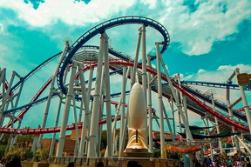

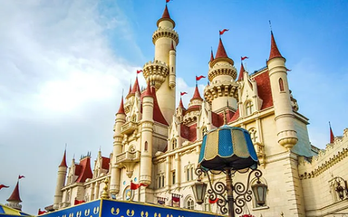
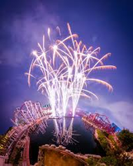
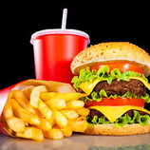
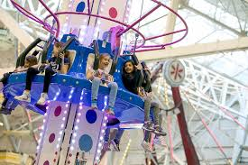

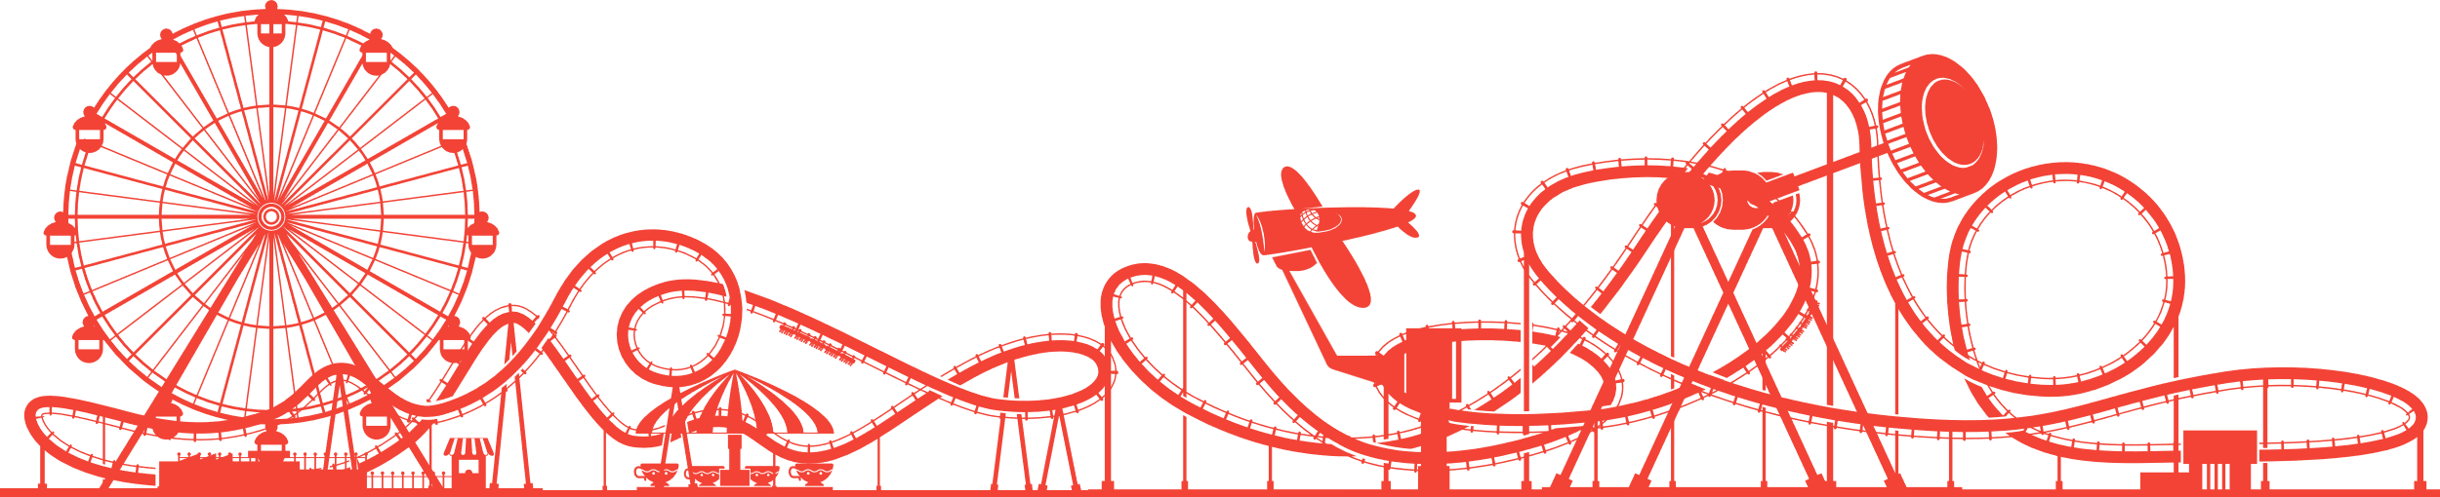
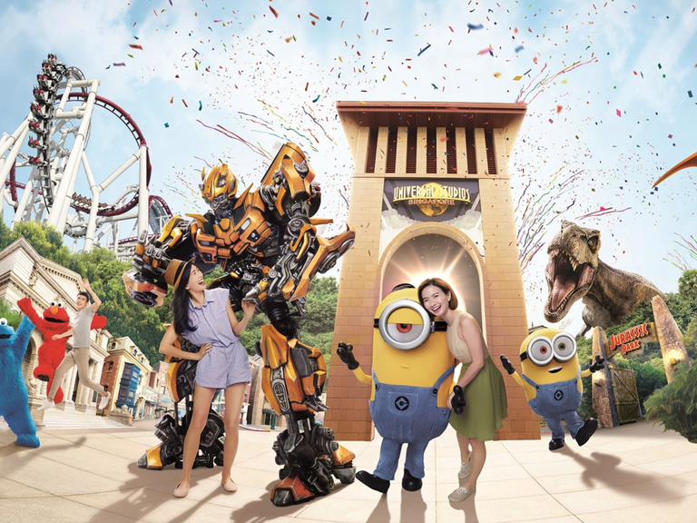
Multiversal Studios
BEgin

Slide 3








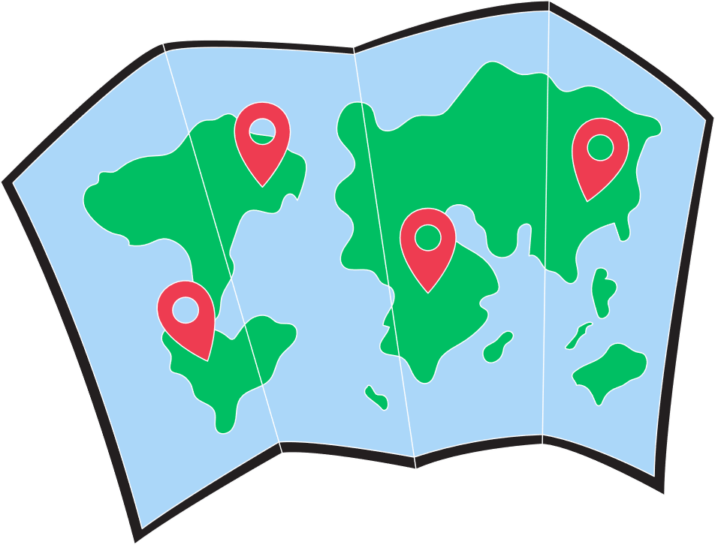
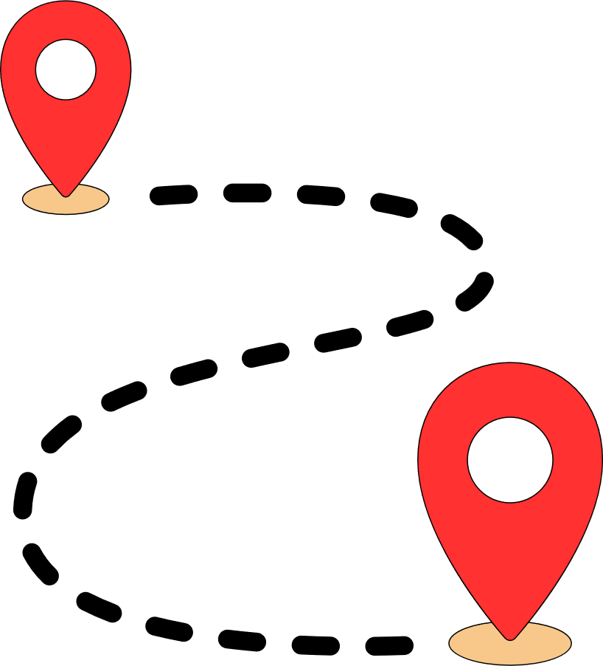
English
Hi, I am Kiki!
Looks like you are new.
Map
Plan Trip

Slide 4
Mandarin
你好，我是琪琪！ 看起来你是新来的。
地图
计划旅行

Slide 5

English
Hi, I am Kiki!
Looks like you are new.
Map
Plan Trip

Slide 6
English
Hi, I am Kiki!
Looks like you are new.
Are you sure you want to exit?
No
Yes
Map
Plan Trip

Slide 7
English
Hi, I am Kiki!
Looks like you are new.
English
Mandarin
Malay
Tamil
s
More
Map
Plan Trip

Slide 8
English
Aymara
Arabic
Basque
Belarusian
Bengali
Bislama
Bulgarian
Burmese
Czech
Croatian
Dutch
English
Estonian
Fijian
Finnish
French
Hi, I am Kiki!
Looks like you are new.
s
Map
Plan Trip

Slide 9
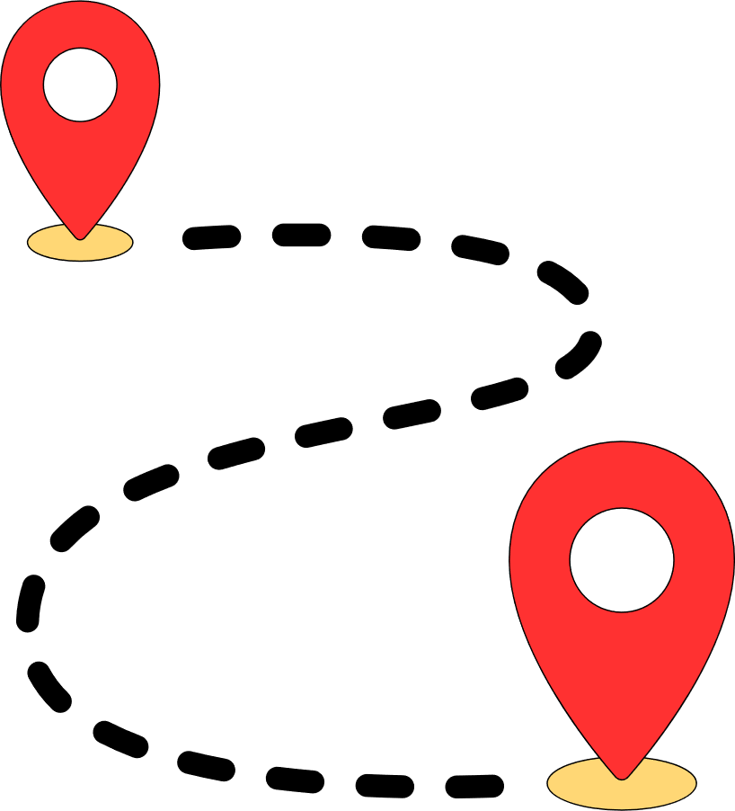
English
Hi, welcome back!
Glad to see you again.
Map
View Trip

Slide 10
English
Hi!
Ferris Wheel will be undergoing maintenance from 5pm to 6pm.
Map
View Trip

Slide 11
English
Hi!
Ferris Wheel will be undergoing maintenance from 5pm to 6pm.
Are you sure you want to exit?
No
Yes
Map
View Trip

Slide 12
English
Hi, welcome back!
Glad to see you again.
Are you sure you want to exit?
No
Yes
Map
View Trip

Slide 13


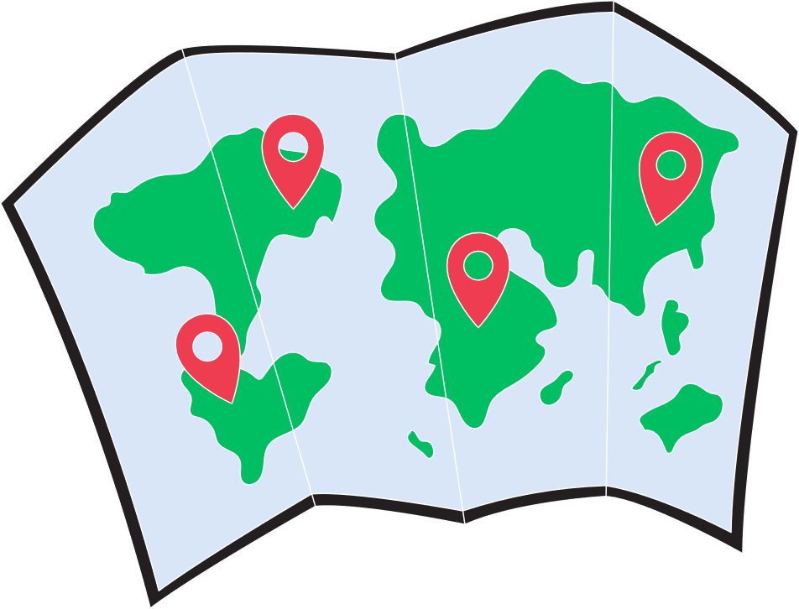
English
Hi, I am Kiki!
Looks like you are new.
Rate your experience
Tell us more (optional)
Submit
Map
View Trip

Slide 14



General FAQs
What are the park’s opening hours?
Can I buy tickets at the park?
What if it rains?
‘How to use Kiosk’ Guide
Contact for help

Slide 15
General FAQs
What are the park’s opening hours?
We’re open daily from 10 AM to 10 PM — ready for fun from morning till night!
What if it rains?
‘How to use Kiosk’ Guide
Contact for help

Slide 16





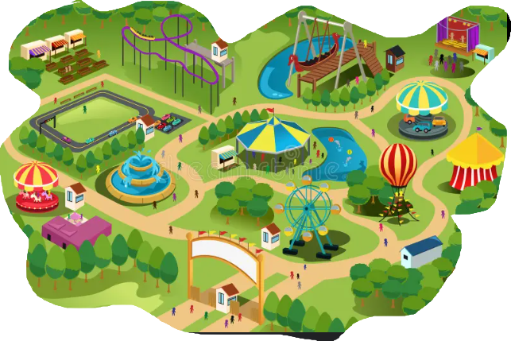






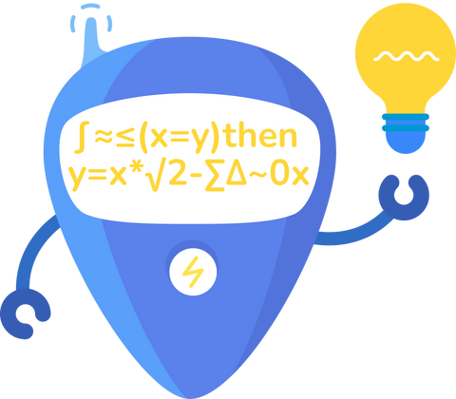






List of all places
Multiversal Studios Map
Burger Queen
Avg. Waiting Time: 19 mins
Castle Playtime
Avg. Waiting Time: 20 mins
Bumper cars
Avg. Waiting Time: 15 mins
Pizza House
Avg. Waiting Time: 17 mins
Dining
Music show
Rides
Shows
Avg. Waiting Time: 14 mins
Others
Fireworks
Quick Tip:
You may add places you like to ‘Favorites ’ to plan your trip quickly.
Avg. Waiting Time: 50 mins
Ok
No More tips
Ok
More tips
Ice Cream Corner
Avg. Waiting Time: 5 mins
Ferris wheels
Browse Videos
Browse Photos
Plan Trip
Avg. Waiting Time: 23 mins

Slide 17
List of all places
Multiversal Studios Map
Burger Queen
Avg. Waiting Time: 19 mins
Castle Playtime
Avg. Waiting Time: 20 mins
Bumper cars
Avg. Waiting Time: 15 mins
Pizza House
Avg. Waiting Time: 17 mins
Dining
Music show
Rides
Shows
Avg. Waiting Time: 14 mins
Others
Fireworks
Quick Tip:
You may add places you like to ‘Favorites ’ to plan your trip quickly.
Avg. Waiting Time: 50 mins
Ok
No More tips
Ok
More tips
Ice Cream Corner
Avg. Waiting Time: 5 mins
Ferris wheels
Browse Videos
Browse Photos
Plan Trip
Avg. Waiting Time: 23 mins

Slide 18
List of all places
Multiversal Studios Map
Burger Queen
Avg. Waiting Time: 19 mins
Castle Playtime
Avg. Waiting Time: 20 mins
Bumper cars
Avg. Waiting Time: 15 mins
Pizza House
Avg. Waiting Time: 17 mins
Dining
Music show
Rides
Shows
Avg. Waiting Time: 14 mins
Others
Fireworks
Quick Tip:
You may filter the map to see your desired places.
Avg. Waiting Time: 50 mins
Ok
No More tips
Ok
More tips
Ice Cream Corner
Avg. Waiting Time: 5 mins
Ferris wheels
Browse Videos
Browse Photos
Plan Trip
Avg. Waiting Time: 23 mins

Slide 19
List of all places
Multiversal Studios Map
Burger Queen
Avg. Waiting Time: 19 mins
Castle Playtime
Avg. Waiting Time: 20 mins
Bumper cars
Avg. Waiting Time: 15 mins
Pizza House
Avg. Waiting Time: 17 mins
Dining
Music show
Rides
Shows
Avg. Waiting Time: 14 mins
Others
Fireworks
Avg. Waiting Time: 50 mins
Ice Cream Corner
Avg. Waiting Time: 5 mins
Ferris wheels
Browse Videos
Browse Photos
Plan Trip
Avg. Waiting Time: 23 mins

Slide 20


Slide 21

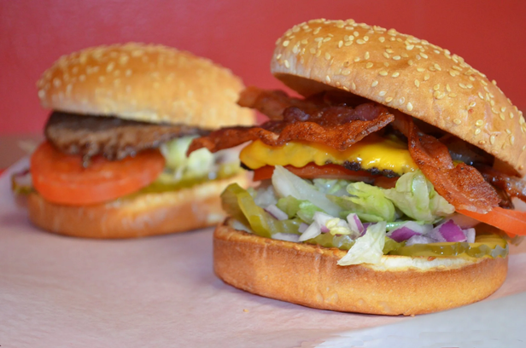
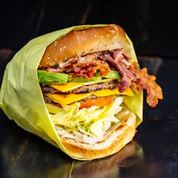

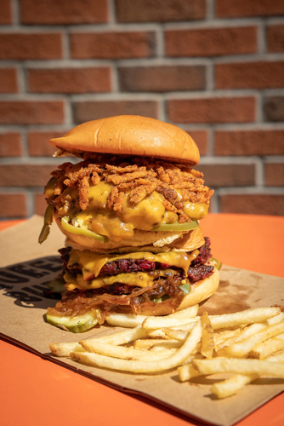
List of all places
Multiversal Studios Map
Burger Queen
Avg. Waiting Time: 19 mins
Castle Playtime
Avg. Waiting Time: 20 mins
Bumper cars
Photos
Avg. Waiting Time: 15 mins
Pizza House
Avg. Waiting Time: 17 mins
Dining
Music show
Rides
Shows
Avg. Waiting Time: 14 mins
Others
Fireworks
Quick Tip:
You may add places you like to ‘Favourites ’ to plan your trip quickly.
Avg. Waiting Time: 50 mins
Ok
No More tips
Ok
More tips
Ice Cream Corner
Avg. Waiting Time: 5 mins
Ferris wheels
Browse Videos
Browse Photos
Plan Trip
Avg. Waiting Time: 23 mins

Slide 22

List of all places
Multiversal Studios Map
Burger Queen
Avg. Waiting Time: 19 mins
Castle Playtime
Avg. Waiting Time: 20 mins
Bumper cars
Avg. Waiting Time: 15 mins
Videos
Pizza House
Avg. Waiting Time: 17 mins
Dining
Music show
Rides
Shows
Avg. Waiting Time: 14 mins
Others
Fireworks
Quick Tip:
You may add places you like to ‘Favourites ’ to plan your trip quickly.
Avg. Waiting Time: 50 mins
Ok
No More tips
Ok
More tips
Ice Cream Corner
Avg. Waiting Time: 5 mins
Ferris wheels
Browse Videos
Browse Photos
Plan Trip
Avg. Waiting Time: 23 mins

Slide 23

List of all places
Multiversal Studios Map
Burger Queen
Avg. Waiting Time: 19 mins
Castle Playtime
Avg. Waiting Time: 20 mins
Bumper cars
Avg. Waiting Time: 15 mins
Ferris wheels
Avg. Waiting Time: 23 mins
Pizza House
Avg. Waiting Time: 17 mins
Dining
Music show
Rides
Shows
Avg. Waiting Time: 14 mins
Others
Fireworks
Quick Tip:
You may add places you like to ‘Favourites ’ to plan your trip quickly.
Avg. Waiting Time: 50 mins
Ok
No More tips
Ok
More tips
Ice Cream Corner
Avg. Waiting Time: 5 mins
Ferris wheels
Browse Videos
Browse Photos
Plan Trip
Avg. Waiting Time: 23 mins

Slide 24
List of all places
Multiversal Studios Map
Burger Queen
Avg. Waiting Time: 19 mins
Castle Playtime
Avg. Waiting Time: 20 mins
Bumper cars
Avg. Waiting Time: 15 mins
Pizza House
Avg. Waiting Time: 17 mins
Music show
Dining
Rides
Avg. Waiting Time: 14 mins
Shows
Others
Fireworks
Quick Tip:
You may add places you like to ‘Favourites ’ to plan your trip quickly.
Avg. Waiting Time: 50 mins
Ok
No More tips
Ok
More tips
Ice Cream Corner
Avg. Waiting Time: 5 mins
Ferris wheels
Browse Videos
Browse Photos
Plan Trip
Avg. Waiting Time: 23 mins

Slide 25
List of all places
Multiversal Studios Map
Burger Queen
Avg. Waiting Time: 19 mins
Castle Playtime
Filters
Avg. Waiting Time: 20 mins
Dining
Bumper cars
Rides
Avg. Waiting Time: 15 mins
Shows
Pizza House
Others
Avg. Waiting Time: 17 mins
Dining
Music show
Rides
Shows
Avg. Waiting Time: 14 mins
Others
Fireworks
Quick Tip:
You may add places you like to ‘Favourites ’ to plan your trip quickly.
Avg. Waiting Time: 50 mins
Ok
No More tips
Ok
More tips
Ice Cream Corner
Avg. Waiting Time: 5 mins
Ferris wheels
Browse Videos
Browse Photos
Plan Trip
Avg. Waiting Time: 23 mins

Slide 26
List of all places
Multiversal Studios Map
Burger Queen
Avg. Waiting Time: 19 mins
Castle Playtime
Avg. Waiting Time: 20 mins
Burger Queen
Bumper cars
📋 Key Information
Type: Fast food / Casual dining
Signature Items: Queen’s Classic Burger, Royal Spicy Melt, Crispy Fries, Hand-Spun Shakes
Average Price Range: $6 – $15 per person
Average Waiting Time: 8–12 minutes during regular hours; up to 20 minutes at peak times
Average Delivery Time: 25–35 minutes (may vary by location)
Seating Capacity: Around 40–50 guests
Avg. Waiting Time: 15 mins
Pizza House
Burger Queen 👑
Welcome to Burger Queen, the ultimate destination for burger lovers! We serve up juicy, freshly grilled burgers made with 100% premium beef, fluffy golden buns, and all your favorite toppings — made just the way you like them. From our signature Queen’s Classic to our bold Royal Spicy Melt, every bite is packed with flavor fit for royalty.
Pair your burger with crispy fries, creamy milkshakes, and our secret house sauces for the perfect meal. Whether you’re dining in with friends, grabbing takeout, or ordering delivery, Burger Queen promises fast service, great taste, and a touch of royal treatment every time you visit
Avg. Waiting Time: 17 mins
Dining
Music show
Rides
Shows
Avg. Waiting Time: 14 mins
Others
Fireworks
Quick Tip:
You may add places you like to ‘Favourites ’ to plan your trip quickly.
Avg. Waiting Time: 50 mins
Ok
No More tips
Ok
More tips
Ice Cream Corner
Avg. Waiting Time: 5 mins
Ferris wheels
Browse Videos
Browse Photos
Plan Trip
Avg. Waiting Time: 23 mins

Slide 27







Plan Trip
Type
1.
Burger Queen
15 m
10:00 - 10:30
Individual
2.
Castle Playtime
Average Waiting Time
10:35 - 11:30
70 m
-
25
+
mins
3.
Bumper cars
25 m
11:35 - 12:05
Reset
Save
4.
Pizza House
12:10 - 12:50
100 m
5.
Music Show
12:55 - 13.30
250 m
6.
Ferris wheels
13:40 - 14.30
500 m
7.
Ice Cream Corner
14:35 - 14.55
2500 m
Let Kiki help you plan quickly.
8.
Fireworks
18:00 - 19:00
120 m
No
Yes

Slide 28
Plan Trip
Type
1.
Burger Queen
15 m
10:00 - 10:30
Individual
2.
Castle Playtime
Average Waiting Time
10:35 - 11:30
70 m
-
25
+
mins
Do you want to save changes before exiting?
3.
Bumper cars
25 m
11:35 - 12:05
Reset
Save
4.
Pizza House
12:10 - 12:50
100 m
Music Show
Don’t Save
Save
5.
250 m
12:55 - 13.30
6.
Ferris wheels
13:40 - 14.30
500 m
7.
Ice Cream Corner
14:35 - 14.55
2500 m
Let Kiki help you plan quickly.
8.
Fireworks
18:00 - 19:00
120 m
No
Yes

Slide 29
Plan Trip
Type
1.
Burger Queen
15 m
10:00 - 10:30
Individual
2.
Castle Playtime
Average Waiting Time
10:35 - 11:30
70 m
-
25
+
mins
3.
Bumper cars
25 m
11:35 - 12:05
Reset
Save
4.
Pizza House
12:10 - 12:50
100 m
5.
Music Show
12:55 - 13.30
250 m
6.
Ferris wheels
13:40 - 14.30
500 m
7.
Ice Cream Corner
14:35 - 14.55
2500 m
8.
Fireworks
18:00 - 19:00
120 m

Slide 30
Plan Trip
Type
1.
Burger Queen
15 m
10:00 - 10:30
Individual
2.
Castle Playtime
Average Waiting Time
10:35 - 11:30
70 m
-
25
+
mins
3.
Bumper cars
11:35 - 12:05
25 m
Reset
Save
4.
Pizza House
12:10 - 12:50
100 m
5.
Music Show
12:55 - 13.30
250 m
6.
Ferris wheels
13:40 - 14.30
500 m
7.
Ice Cream Corner
14:35 - 14.55
2500 m

Slide 31
Plan Trip
Type
1.
Burger Queen
15 m
10:00 - 10:30
Individual
Group
2.
Castle Playtime
Average Waiting Time
10:35 - 11:30
70 m
Individual
25
+
mins
3.
Split Group
Bumper cars
11:35 - 12:05
25 m
Reset
Save
4.
Pizza House
12:10 - 12:50
100 m
5.
Music Show
12:55 - 13.30
250 m
6.
Ferris wheels
13:40 - 14.30
500 m
7.
Ice Cream Corner
14:35 - 14.55
2500 m
Let Kiki help you plan quickly.
8.
Fireworks
18:00 - 19:00
120 m
No
Yes

Slide 32
Plan Trip
Type
1.
Burger Queen
15 m
10:00 - 10:30
Group
Group
2.
Castle Playtime
Average Waiting Time
10:35 - 11:30
70 m
Individual
25
+
mins
3.
Split Group
Bumper cars
11:35 - 12:05
25 m
Reset
Save
4.
Pizza House
12:10 - 12:50
100 m
5.
Music Show
12:55 - 13.30
250 m
6.
Ferris wheels
13:40 - 14.30
500 m
7.
Ice Cream Corner
14:35 - 14.55
2500 m
Let Kiki help you plan quickly.
8.
Fireworks
18:00 - 19:00
120 m
No
Yes

Slide 33
Plan Trip
1.
Burger Queen
Group
10:00 - 10:30
15 m
Average Waiting Time
2.
-
Castle Playtime
10:35 - 11:30
70 m
25
+
mins
Group Type
Family
3.
Bumper cars
25 m
11:35 - 12:05
Members
5
+
4.
Pizza House
Reset
Save
12:10 - 12:50
100 m
5.
Music Show
12:55 - 13.30
250 m
6.
Ferris wheels
13:40 - 14.30
500 m
7.
Ice Cream Corner
14:35 - 14.55
2500 m
Let Kiki help you plan quickly.
8.
Fireworks
18:00 - 19:00
120 m
No
Yes

Slide 34
Plan Trip
1.
Burger Queen
Group
10:00 - 10:30
15 m
Average Waiting Time
2.
-
Castle Playtime
10:35 - 11:30
70 m
25
+
mins
Group Type
Family
3.
Bumper cars
25 m
11:35 - 12:05
Members
5
+
4.
Pizza House
Reset
Save
12:10 - 12:50
100 m
5.
Music Show
12:55 - 13.30
250 m
6.
Ferris wheels
13:40 - 14.30
500 m
7.
Ice Cream Corner
14:35 - 14.55
2500 m
8.
Fireworks
18:00 - 19:00
120 m

Slide 35
Plan Trip
1.
Burger Queen
Group
10:00 - 10:30
15 m
Average Waiting Time
2.
-
Castle Playtime
10:35 - 11:30
70 m
25
+
mins
Group Type
Family
3.
Bumper cars
25 m
Corporate
11:35 - 12:05
Members
Reset
Couple
Save
4.
Pizza House
Family
12:10 - 12:50
100 m
Friends
Sav
5.
Music Show
Seniors
12:55 - 13.30
250 m
Others
6.
Ferris wheels
13:40 - 14.30
500 m
7.
Ice Cream Corner
14:35 - 14.55
2500 m
Let Kiki help you plan quickly.
8.
Fireworks
18:00 - 19:00
120 m
No
Yes

Slide 36
Plan Trip
Type
1.
Burger Queen
15 m
10:00 - 10:30
Split Group
Group
2.
Castle Playtime
Average Waiting Time
10:35 - 11:30
70 m
Individual
25
+
mins
3.
Split Group
Bumper cars
11:35 - 12:05
25 m
Reset
Save
4.
Pizza House
12:10 - 12:50
100 m
5.
Music Show
12:55 - 13.30
250 m
6.
Ferris wheels
13:40 - 14.30
500 m
7.
Ice Cream Corner
14:35 - 14.55
2500 m
Let Kiki help you plan quickly.
8.
Fireworks
18:00 - 19:00
120 m
No
Yes

Slide 37
Plan Trip
Group
Subgroup 1
Subgroup 2
Type
Split Group
1.
Burger Queen
15 m
Average Waiting Time
10:00 - 10:30
-
25
+
mins
2.
Castle Playtime
10:35 - 11:30
70 m
Group Type
Family
-
3.
Bumper cars
11:35 - 12:05
25 m
Members
-
5
+
Subgroup 1
2
-
+
4.
Pizza House
12:10 - 12:50
Subgroup 2
3
100 m
+
+
Add Subgroup
Music Show
12:55 - 13.30
Reset
Save
5.
250 m
6.
Ferris wheels
13:40 - 14.30
500 m
7.
Ice Cream Corner
14:35 - 14.55
2500 m
Let Kiki help you plan quickly.
8.
Fireworks
18:00 - 19:00
No
Yes
200 m

Slide 38
Plan Trip
Group
Subgroup 1
Subgroup 2
Type
Split Group
1.
Burger Queen
15 m
Average Waiting Time
10:00 - 10:30
-
25
+
mins
2.
Castle Playtime
10:35 - 11:30
70 m
Group Type
Family
-
3.
Bumper cars
11:35 - 12:05
25 m
Members
-
5
+
Subgroup 1
2
-
+
4.
Pizza House
12:10 - 12:50
Subgroup 2
3
100 m
+
+
Add Subgroup
Music Show
12:55 - 13.30
Reset
Save
5.
250 m
6.
Ferris wheels
13:40 - 14.30
500 m
7.
Ice Cream Corner
14:35 - 14.55
2500 m
8.
Fireworks
18:00 - 19:00
200 m

Slide 39
Plan Trip
Group
Subgroup 1
Subgroup 2
Type
Split Group
1.
Burger Queen
Group
10:00 - 10:30
15 m
Average Waiting Time
Individual
25
+
mins
2.
Castle Playtime
10:35 - 11:30
70 m
Split Group
3.
Bumper cars
11:35 - 12:05
Reset
Save
25 m
Reset
4.
Pizza House
12:10 - 12:50
100 m
Music Show
12:55 - 13.30
5.
250 m
6.
Ferris wheels
13:40 - 14.30
500 m
7.
Ice Cream Corner
14:35 - 14.55
2500 m
Let Kiki help you plan quickly.
8.
Fireworks
18:00 - 19:00
No
Yes
200 m

Slide 40

Confirmed Plan
1.
Burger Queen
10:00 - 10:30
15 m
2.
Castle Playtime
10:35 - 11:30
70 m
3.
Bumper cars
11:35 - 12:05
25 m
4.
Pizza House
12:10 - 12:50
100 m
5.
Music Show
12:55 - 13.30
250 m
6.
Ferris wheels
13:40 - 14.30
500 m
7.
Ice Cream Corner
14:35 - 14.55
2500 m
8.
Fireworks
18:00 - 19:00
120 m
Edit
Home

Slide 41
Confirmed Plan
Subgroup 1
Subgroup 2
Group
1.
Burger Queen
10:00 - 10:30
15 m
2.
Castle Playtime
10:35 - 11:30
70 m
3.
Bumper cars
11:35 - 12:05
25 m
4.
Pizza House
120 m
12:10 - 12:50
5.
Music Show
12:55 - 13.30
100 m
6.
Ferris wheels
13:40 - 14.30
250 m
7.
Ice Cream Corner
14:35 - 14.55
500 m
8.
Fireworks
18:00 - 19:00
2500 m
Edit
Home

